Slide 1
Astro 18: Planets and Planetary Systems
Lecture 1: Overview
Planet Jupiter
Claire Max
April 1, 2014
http://www.ucolick.org/~max/Astro18-2014/Astro18.html

Slide 2
Outline of this lecture
Overview of our Solar System and of other planetary systems
Five minute break
  Please remind me to stop at 12:45 pm!
Overview of Astro 18
  What is the course about?
  Goals of the course
  How the course will work

Slide 3
Two main topics for course:
Our Solar System
Other planetary systems

Slide 4
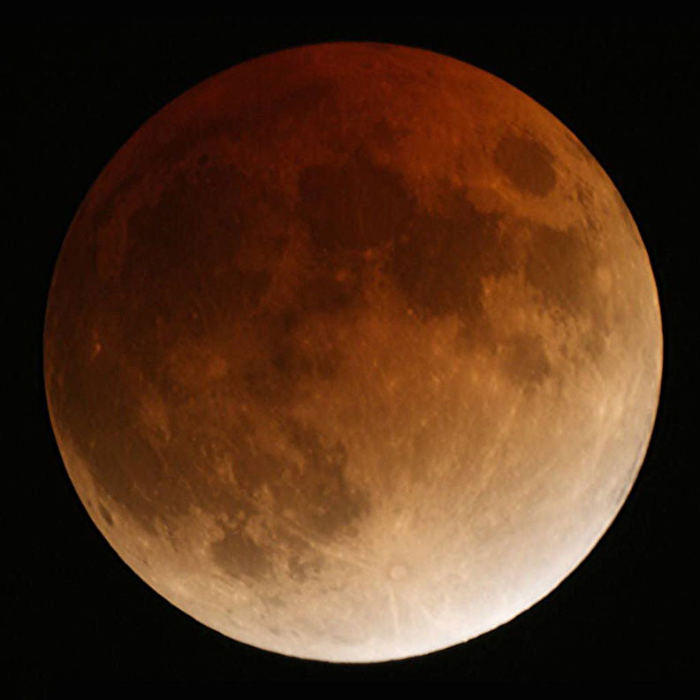
Total eclipse of the moon the night of April 14th-15th (!)
We will watch it together

Slide 5

First…
Who has seen a planet? What did it look like?
Who has looked through a telescope? What did you see?

Slide 6
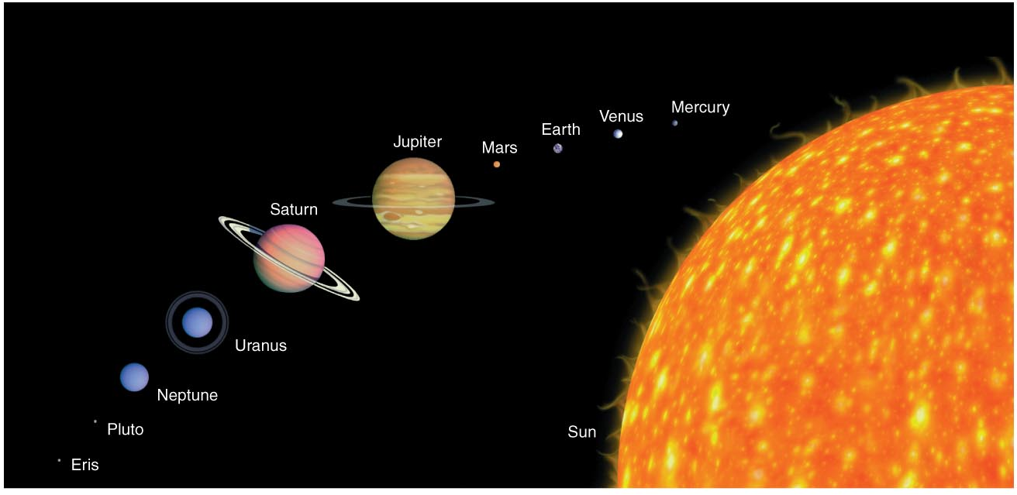
Our Own Solar System
Inhabitants: Sun, planets, asteroids, comets
Relative sizes are in correct proportions
Relative distances are all wrong here

Slide 7
Sub-categories of planets
“Terrestrial”
“Giant”
“Dwarf Planets”

Slide 8

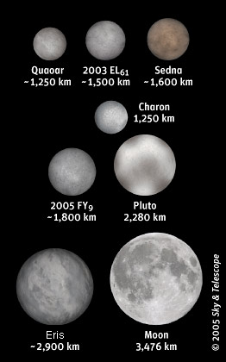
Status of (poor old) Pluto?
In 2007 the International Astronomical Union voted that Pluto and bodies like it were “dwarf planets”
Not “real planets”
Very contentious!
We’ll discuss this in a later lecture
It turns out there are many Pluto-like
objects in our Solar System

Slide 9
How to remember order of planets?
Mercury Venus Earth Mars Jupiter Saturn Uranus Neptune (Pluto?)
Mnemonic: a sentence with same first letters of words. Helps remember a list. Examples for the original nine planets:
  My very eager mother just sent us nine pizzas
  My very energetic monkey just swung under nine palmtrees
Extra credit on mid-term exam:
  Come up with a new mnemonic for the first eight planets. (Prepare ahead of time). I’ll post them all on web, and we’ll vote on the best.
  Can start at either closest (Mercury) or farthest (Neptune) from Sun.

Slide 10
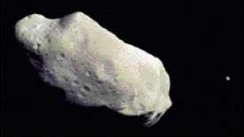
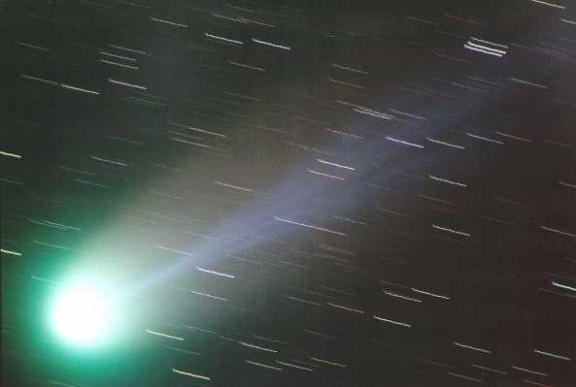
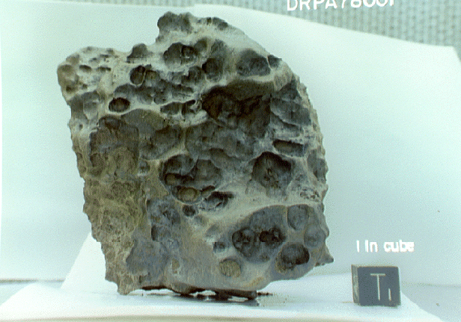
More Solar System inhabitants
Asteroids
Comets
Meteorites
  I’ll bring in my collection
view from Galileo spacecraft

Slide 11
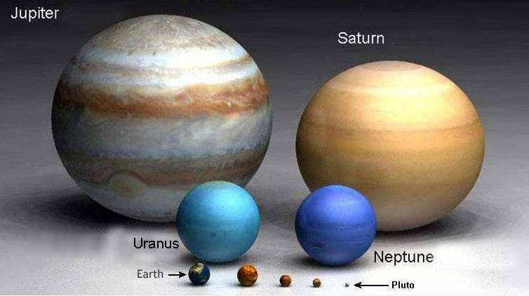
Relative sizes of the Planets

Slide 12
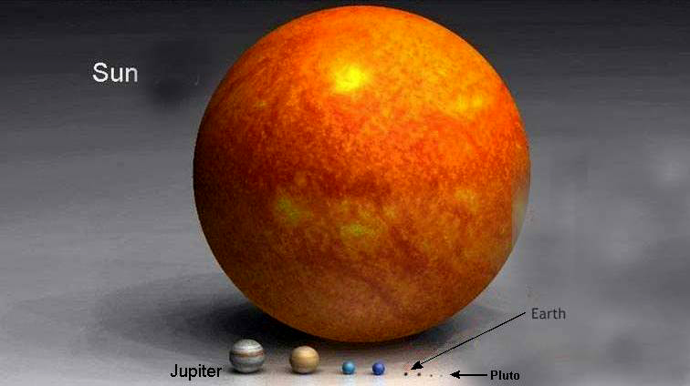
Sizes compared with the Sun (!)

Slide 13
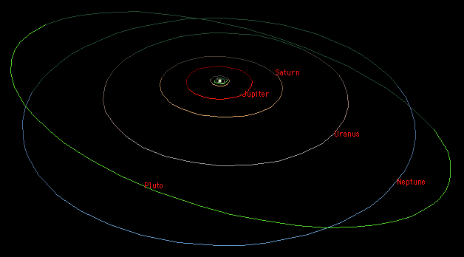
Distances in the Solar System take quite a bit of getting used to
Mercury
Venus
Earth
Mars

Slide 14
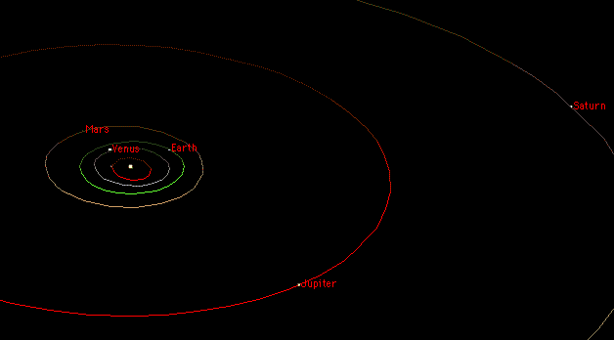
The “Inner Planet” orbits

Slide 15
Scales within the Solar System:
The Sun and the Earth
If the Sun were 0.5 meters in diameter, roughly how big would the Earth be?
    baseball
    ping-pong ball
    pea
How far from the center of the Sun would the Earth’s orbit be?
    at the back of this classroom
    half a football field away
    at the entrance to campus

Slide 16
Scales within the Solar System:
The Sun and the Earth
If the Sun were 0.5 meters in diameter, roughly how big would the Earth be?
    baseball
    ping-pong ball
    pea
How far from the center of the Sun would the Earth’s orbit be?
    at the back of this classroom
    half a football field away
    at the entrance to campus

Slide 17
Scales within the Solar System: the Outer Planets
If the Sun were 0.5 meters in diameter, roughly how big would Jupiter be?
    basketball
    baseball
    ping-pong ball
How far from the center of the Sun would Jupiter’s orbit be?
    half a football field away
b) from here to the entrance to campus
    c) in downtown Santa Cruz
How far would the nearest star be?
    San Francisco
    New York
    Johannesburg South Africa

Slide 18
Scales within the Solar System: the Outer Planets
If the Sun were 0.5 meters in diameter, roughly how big would Jupiter be?
    basketball
    baseball
    ping-pong ball
How far from the center of the Sun would Jupiter’s orbit be?
    half a football field away
b) from here to the entrance to campus
    c) in downtown Santa Cruz
How far would the nearest star be?
    San Francisco
    New York
    Johannesburg South Africa (!)

Slide 19
The Moral of the Tale
Space is VERY EMPTY!

Slide 20
Now a flash tour of the Solar System

Slide 21
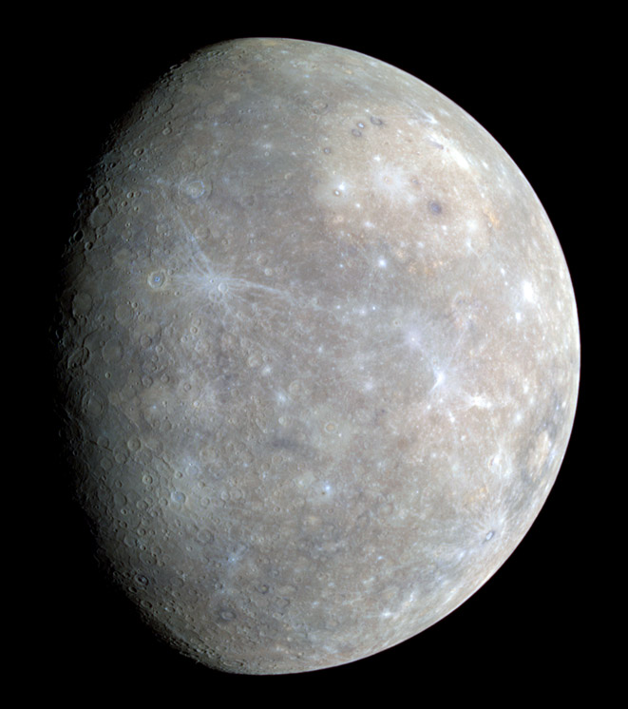
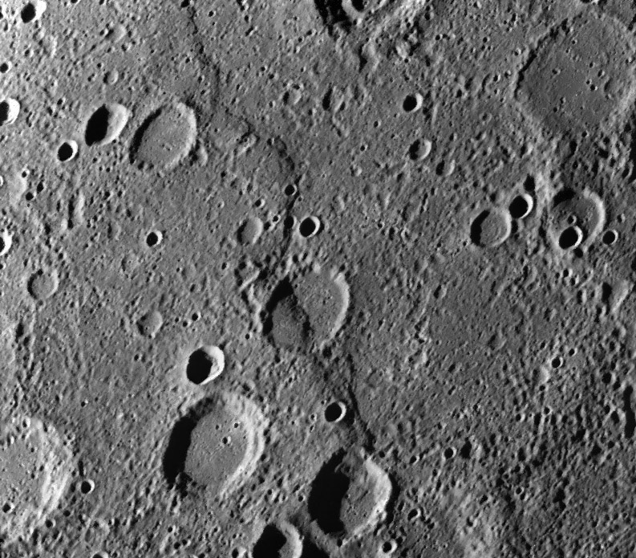
Mercury from Messenger spacecraft: lots of craters, major fault lines/cliffs
Enormous thrust fault line: evidence that Mercury shrank by 1 - 2 km after it solidified (!)

Slide 22
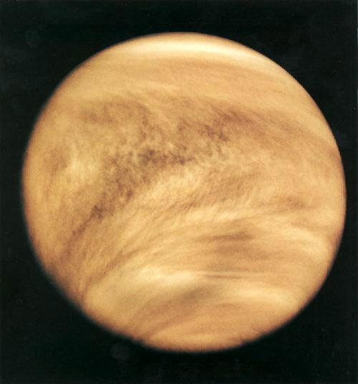
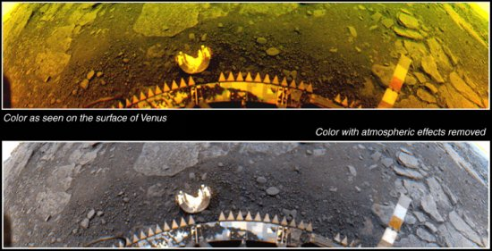
Venus: dense atmosphere, volcanoes, hot surface
Ultra-Violet image showing thick cloud layer (from spacecraft)
Venera 14 lander: hot rocks
Surface temperature > 700K (hotter than Mercury)
Surface pressure 90 x Earth

Slide 23
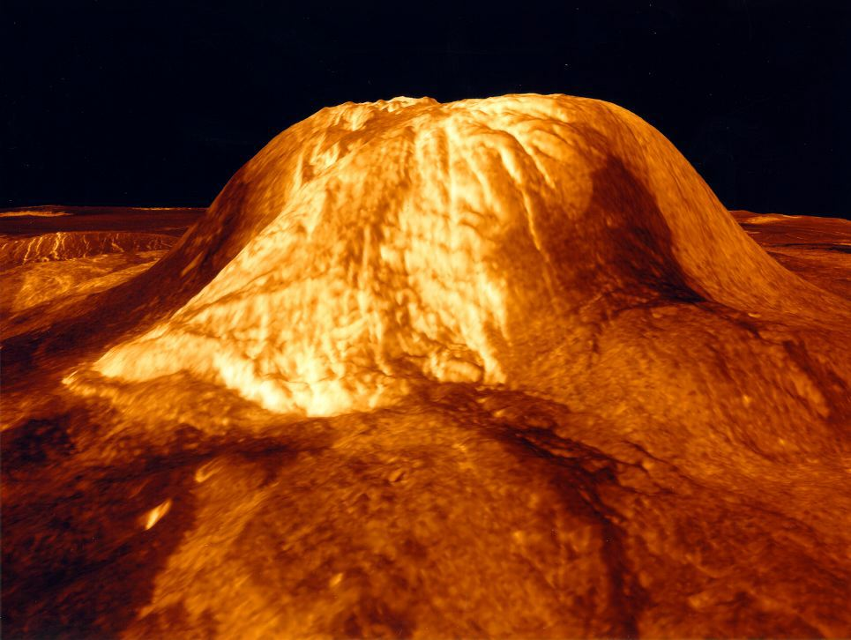
Huge volcanoes on Venus
Topography from Magellan spacecraft (radar measurement)
Gula Mons Volcano

Slide 24
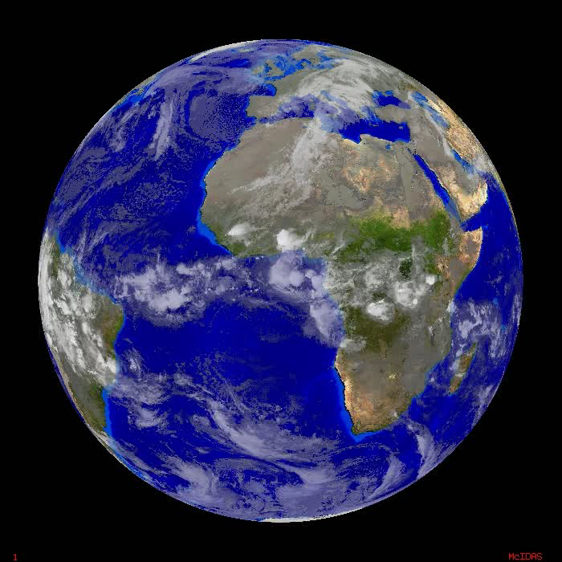
Earth: In the Habitable Zone
What are the conditions for life?
  Not too hot, not too cold – just right
  Liquid water essential
Is our climate changing? Why? How fast?

Slide 25
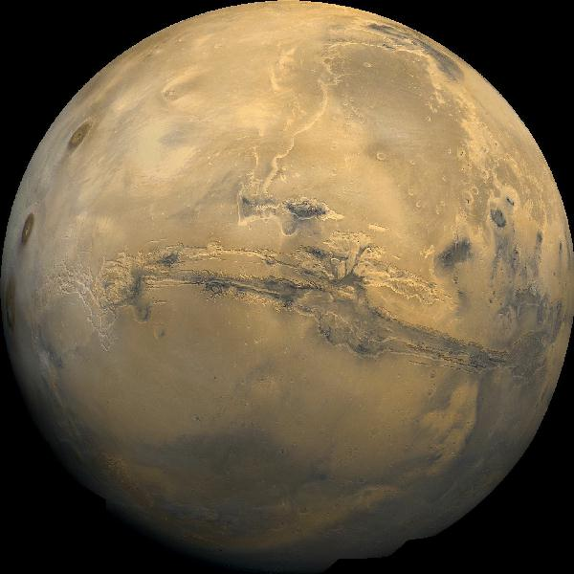
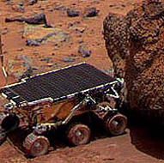
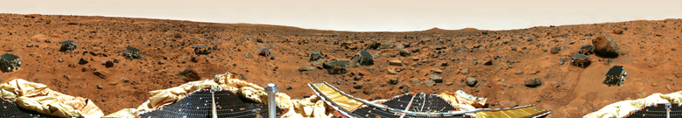
Mars: Not very hospitable right now

Slide 26
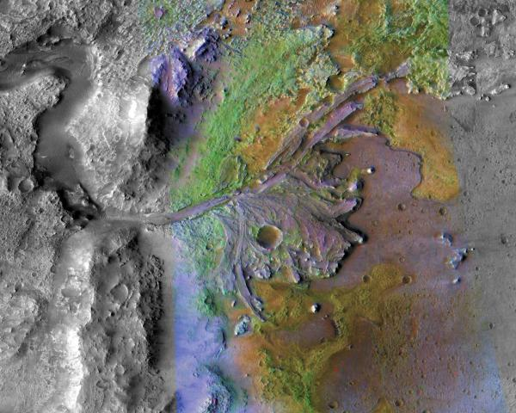
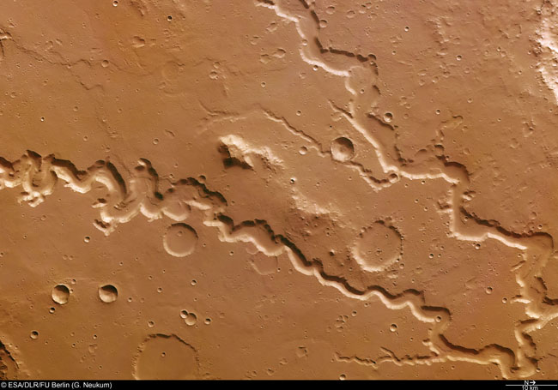
Mars: one piece of evidence for liquid water in the past
Ancient riverbeds?
Did Mars have liquid water in past?
What happened to it?

Slide 27
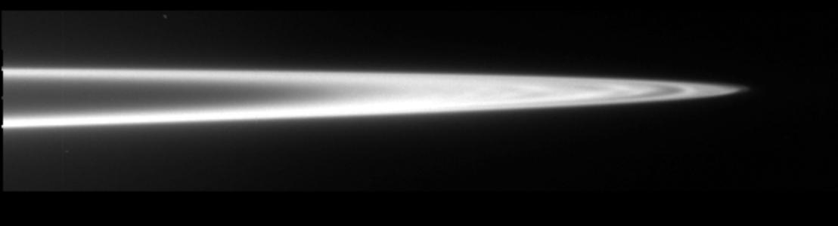
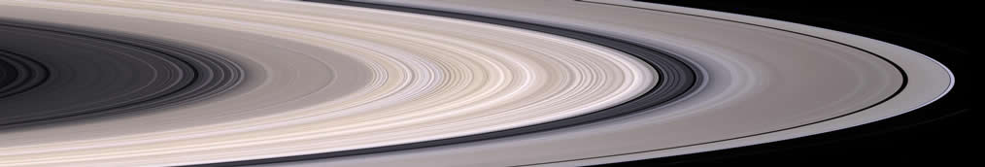
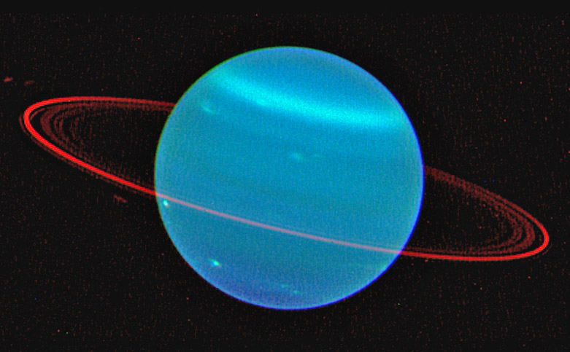
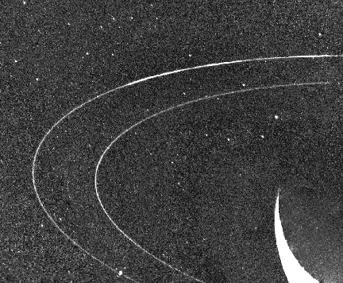
All four Giant Planets have rings!
Where did rings come from?
Jupiter
Saturn
Uranus
Neptune

Slide 28
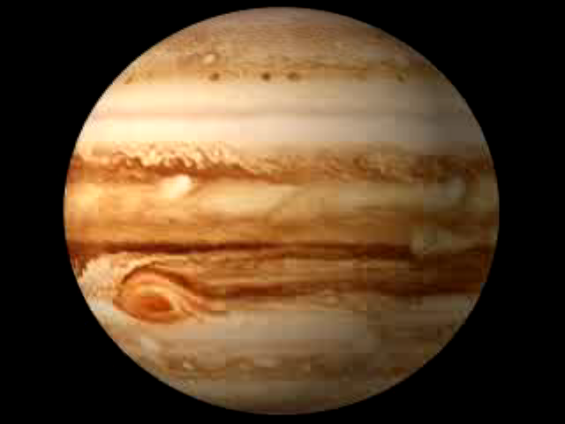
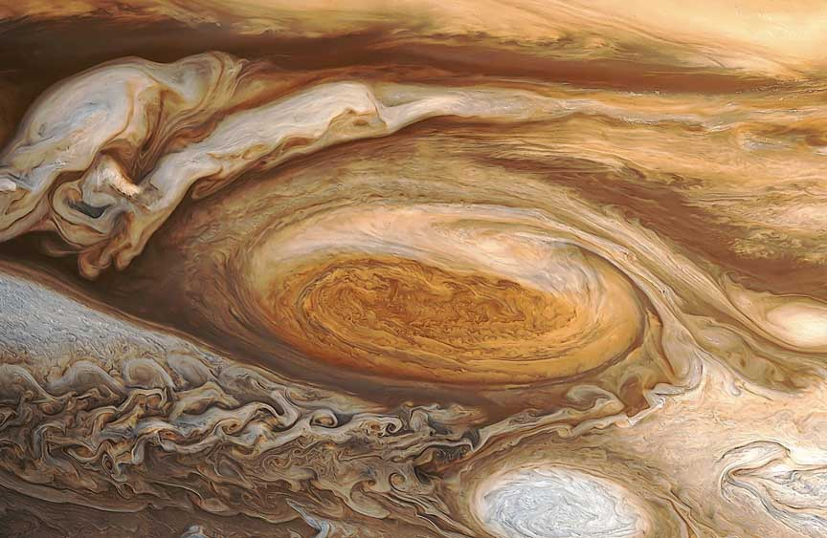
Jupiter
Great Red Spot
ZOOMED IN
Jupiter emits more radiation (as infrared light) than it receives from the sun (in sunlight)
Where does this energy come from?

Slide 29
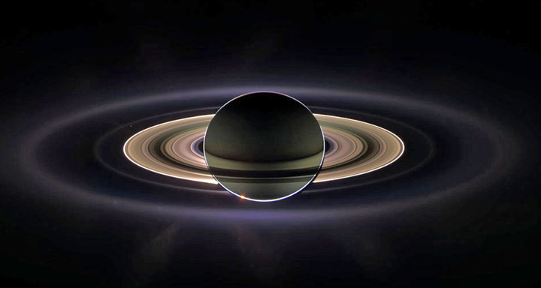
Saturn seen by the Cassini spacecraft

Slide 30
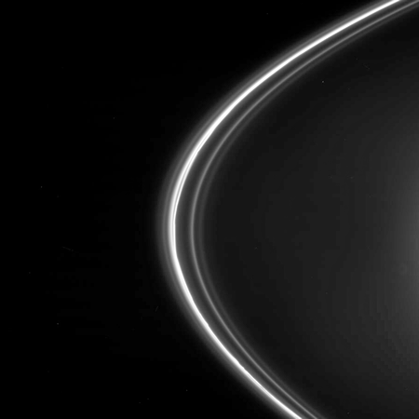
Saturn’s rings from Cassini, cont’d
Moons act as shepherds for rings
Rings are pieces of rock and ice - remnants of moons that broke up?

Slide 31
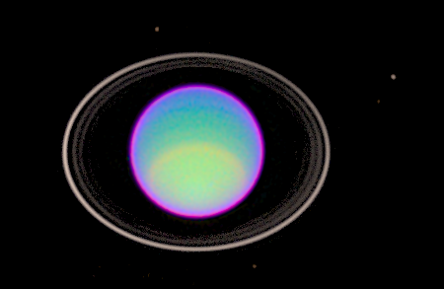
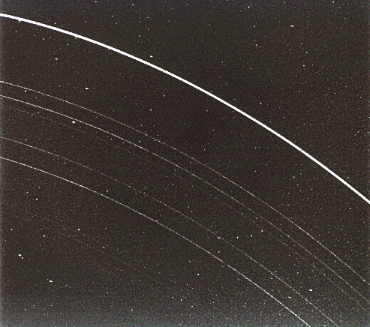
Gas Giants: Uranus and its rings
From Hubble Space Telescope
Closeup from Voyager spacecraft:

Slide 32
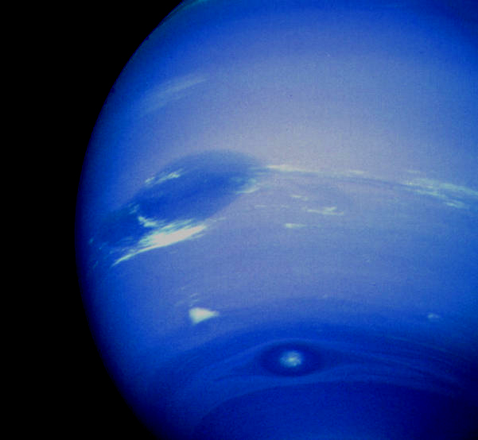
Gas Giants: Neptune in visible light
Visible: Voyager 2 spacecraft, 1989
Compact features such as Great Dark Spot, smaller southern features: probably stable vortex structures

Slide 33

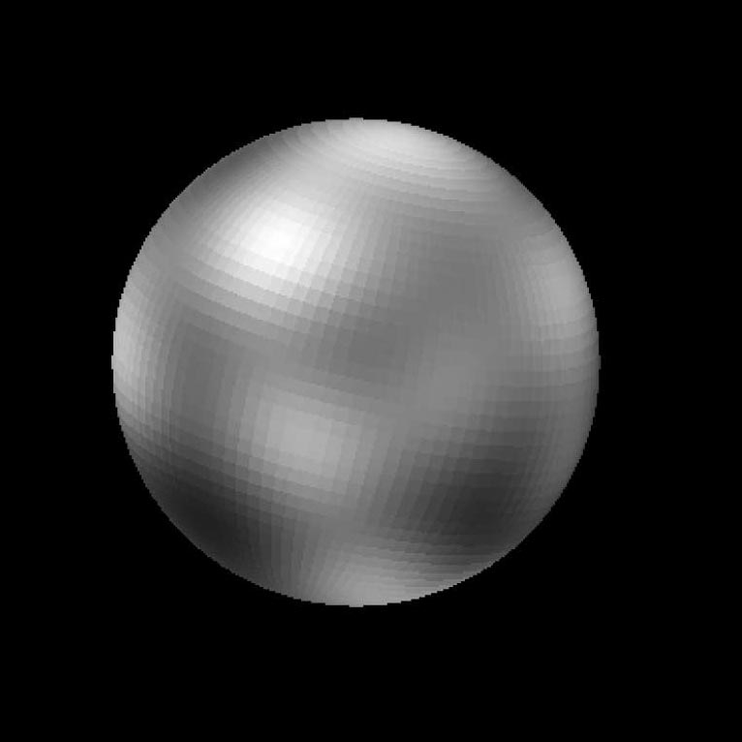
Pluto
Hubble Space Telescope Image Computer model of data
Consensus is that Pluto started out as an asteroid, and later got perturbed into a planetary orbit

Slide 34
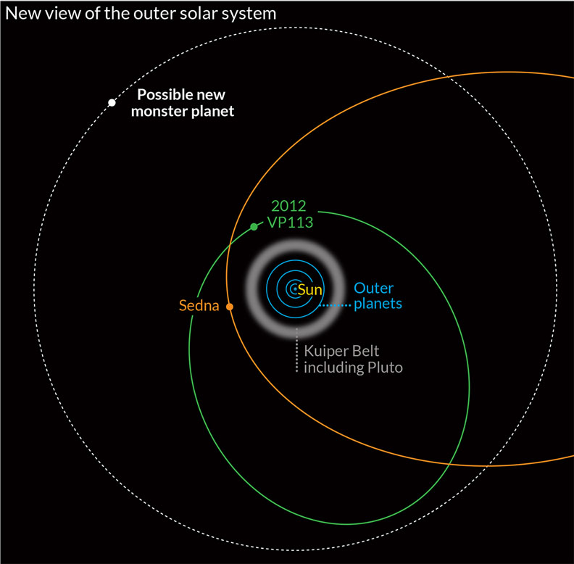
Two Pluto-like objects were just discovered way beyond Pluto’s orbit
VP 113 has a colloquial name: Biden (ha ha)
VP 113 and Sedna may come from the inner edge of the Oort Cloud of comets that surrounds the Solar System

Slide 35
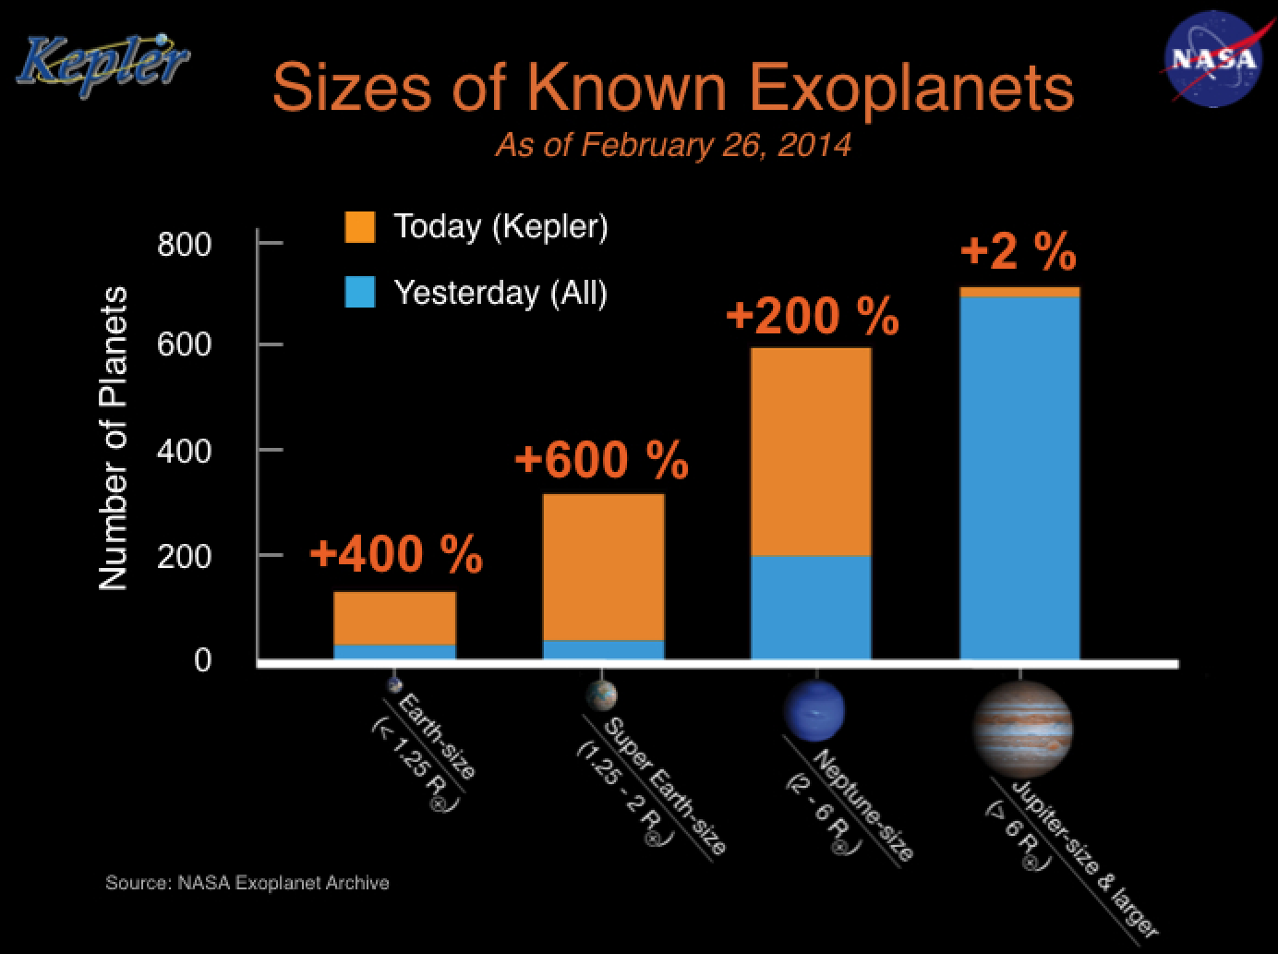
Extrasolar Planetary Systems: Planets around other stars
More than 1700 planets have been confirmed to date !
More than 100 of these are roughly the size of Earth

Slide 36
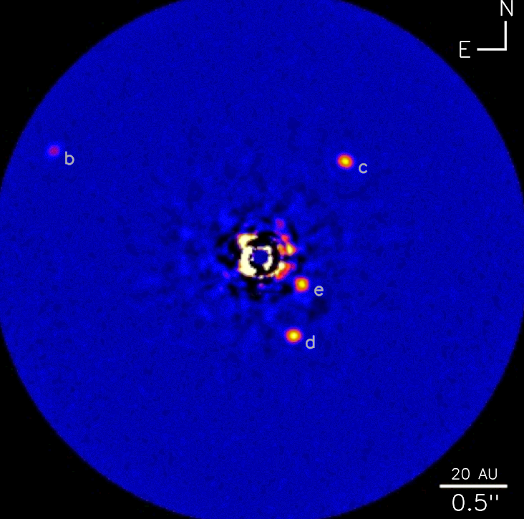
Many tens of extrasolar planets have been imaged directly
The HR 8799 Solar System

Slide 37
It’s time for a break!

Slide 38
Goals of course
Understand the unifying physical concepts underlying planetary formation and evolution
Become familiar with the Solar System - it’s our home in the universe!
Other solar systems besides our own: Join in the excitement of discovery
Gain an appreciation of how science works
Improve your skills in quantitative reasoning

Slide 39
Tools we will use
Physical concepts
  Gravity, energy, light
  Three powerful unifying principles
  Taught in this course
Math tools
  We will use exponential notation, logarithms, algebra
  We will review these in section meetings
  We will make opportunities for those who know calculus to use it, if they are interested
  Other needed tools will be taught in this course

Slide 40
How people learn
The traditional lecture is far from the ideal teaching tool
  Researchers on education study these things rigorously!
I can’t “pour knowledge into you”
Learning is making meaning for oneself.
It is you who must actively engage in the subject matter and assimilate it in a manner that makes it meaningful
This course will emphasize active learning and an understanding of the unifying concepts of planetary science

Slide 41
Concepts vs. plugging in numbers
Lectures will emphasize concepts, challenge you to become critical thinkers
  It is important to know how to calculate things, but concepts are important too
  Difference between learning to plug numbers into equations and learning to analyze unfamiliar situations
Exams will include conceptual problems as well as traditional computational problems
Example: Explain how we can estimate the geological age of a planet’s surface from studying its impact craters.

Slide 42
Elements of the course
Reading
Lectures
Homeworks
Sections, Stargazing
Class Projects
Exams
You should expect to spend 8 to 10 hours a week working on this course outside of class
Plus: I will try to arrange a trip to Lick Observatory
on Mt. Hamilton for those who can make it

Slide 43
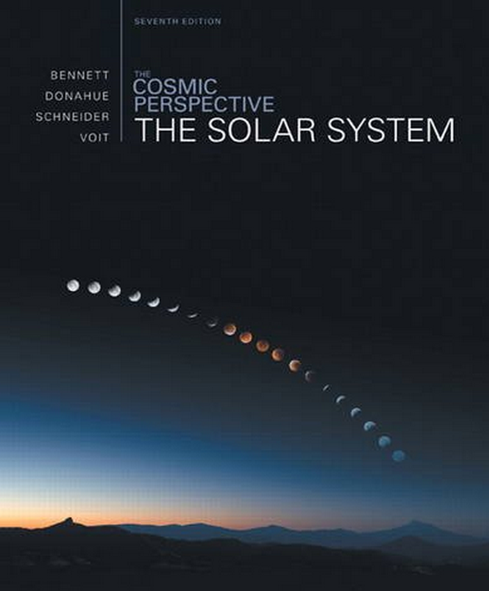
Textbook
The Solar System, 7e Plus Mastering Astronomy ValuePack: ISBN13: 9780321931498
Authors: Bennett, Donahue, Schneider, Voit
Publisher: Addison-Wesley / Pearson
We will be using the textbook’s website, Mastering Astronomy, so you need the “Value Pack” to get media access

Slide 44
Three class websites
http://www.ucolick.org/~max/Astro18-2014/Astro18.html
  My own website for this class
  All class lectures will be posted here
  Class announcements, schedules, homework assignments and solutions, links to useful websites
eCommons: listed under 60617 LEC 01: ASTR ...
http://masteringastronomy.com/
  Website related to the textbook – login info with text
  Some of the homework problems, many self-help tutorials, PDF version of the textbook

Slide 45
Office hours, sections
Claire Max, Professor
  Office hours Thursdays 2:00 – 3:00 pm, Center for Adaptive Optics, room 205
Other meeting times can be arranged in person
Sections will be at times and in a room still to be determined

Slide 46
Reading assignments will be more important than in most science courses
Key for specific knowledge of planetary science and for understanding physical principles
Assignments given at Tuesday lectures, and on web.
I will assume that you have done the reading before each lecture
To provide incentive for you to do the reading before each lecture, there will be a reading quiz at each class
  You will be able to earn bonus points toward your final grade (up to 10 percentage points out of 100 total)

Slide 47
Lectures will discuss underlying concepts, key points, difficult areas
My lectures will be only partly from the textbook
  Nitty gritty details will come from your reading assignments
In-class ConcepTests will provide me with feedback on whether concepts are clear
  I will pose a short conceptual question (no calculations)
  I will ask you to first formulate your own answer, then discuss your answer with two other students, finally to report your consensus answer to me
ConcepTests will not count toward your final grade.
  They are to give me feedback on whether my teaching is clear, and to stimulate discussion

Slide 48
Homeworks due each week
Developing calculation skills
Conceptual questions
Somewhat shorter than the problem-sets usually done in physics classes, because you will also need time to work on Projects
Homework usually due at start of class on Thursdays; handed out 1 week in advance (also on web)

Slide 49
Sections, Stargazing
There will be a section every week, led by me
Sections: to solidify understanding and discuss homeworks
Stargazing: You must attend at least one evening. I will announce in class where and when. Also see
  http://www.astro.ucsc.edu/astronomy_club as soon as it stops raining

Slide 50
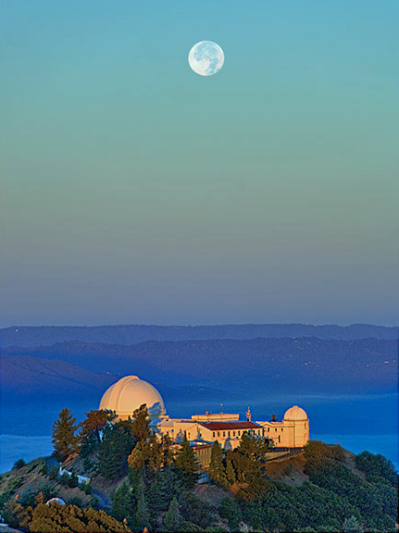
We plan a field trip to Lick Observatory on Mt. Hamilton
Mt. Hamilton is a 4200-ft mountain just east of San Jose
About an hour and a half from here
The first mountain-top observatory in the world
Lots to see: telescopes, labs, lovely views, gift shop

Slide 51
Class Projects will play an important role
Reading, homework, lectures: “content”
  What we know about our Solar System and others, and the scientific tools used to discover this knowledge
Class Projects: “enterprise of science”
  The way we really do science – starting with hunches, making guesses, making many mistakes, going off on blind roads before hitting on one that seems to be going in the right direction
You will choose a general topic. Then you will formulate your own specific questions about the topic, and figure out a strategy for answering them. Work in small groups.
I will provide structure via “milestones” along the way, so you won’t get lost

Slide 52
Grading and exams
Homework 30% of final grade
  Homework turned in one class late will be graded with a grade reduction of 1/2. Homework more than one class period late will not be accepted. Your one lowest-graded homework assignment will not count toward your grade.
Projects 30% of final grade
  Includes both final presentation and written report.
Exams 30% of final grade
  One mid-term, one final exam.
Cl;ass participation, incl. sections 10% of final grade
Extra credit Reading quizzes up to 10%

Slide 53
Classroom Etiquette
We have a lot to learn, so each class meeting is important
Conversation, reading newspapers, and other disturbances will not be tolerated
OK to eat lunch but quietly
Cell phones must be off, laptops closed. No email or text messaging.
If you must leave class early, please clear it with me prior to class and find a seat near the exit.
I will do my best to keep the presentation and discussion lively and interesting!
In return, I expect your attention and participation. This will make your learning experience a gratifying one.

Slide 54
Guidelines for Assignments
Your written work should be clearly understandable
  If a friend of yours were to read your work, would he/she be able to understand exactly what you are trying to say?
  Use proper grammar, syntax, spelling
Homeworks:
  Show your reasoning clearly (don’t just give the final answer)
    We will give partial credit for clear, logical reasoning even if the “bottom line” is wrong
  Include diagrams and sketches whenever they might add insight
  Answer word problems with complete sentences
  Always show what units you are using!
    Meters/sec versus miles/hour versus furlongs/fortnight

Slide 55
Academic Integrity
What is cheating? Presenting someone else’s work as your own.
Examples:
  Copying another student's written homework
  Allowing your own work to be copied
  Although you may discuss problems with fellow students, your collaboration must be at the level of ideas and concepts only
Your homework, project reports, exams, etc. must be written in your own words
Legitimate collaboration ends when you "lend", "borrow", or "trade" written solutions to problems
Talk, discuss, argue with your classmates till you understand. THEN write your OWN text or problem-set in your OWN words.

Slide 56
To enroll in the course if you are not already enrolled
See Maria Sliwinski in the Astronomy Department Office (within the Physics Office)
Interdisciplinary Sciences Bldg rm 211
Phone number: 459-2844
PLEASE: if you decide to drop the class, do so promptly so that others can enroll – there are people waiting to join the class

Slide 57
Reading: Due Tuesday
Buy Textbook
Read Syllabus (class handout today; on web)
Reading:
  The Cosmic Perspective: The Solar System
    Pages XXII-XXIV
    Chapter 1: A Modern View of the Universe
    Chapter 2: Discovering the Universe for Yourself
There will be a Reading Quiz at start of class

Slide 58
First Homework Assignment
Due this Thursday April 3rd: Homework 1: tell me a bit about yourself.
  Email homework to me from the email address you use the most. I will log this as the email address to use for class announcements etc.

Slide 59
Strike Wed and Thurs this week
I live on campus
I will teach a class Thursday for those who choose to come
I will put the lecture (in PowerPoint and PDF) on the class website
I will expect those who choose not to come to class to read the lecture

Slide 60
Most important: Give yourself room to have fun
Go outside at night; look at the planets and stars
  We will learn how to find planets using Stellarium
The Solar System is an amazing place!

